Slide 1
19ECE204
Lecture 8&9

Slide 2
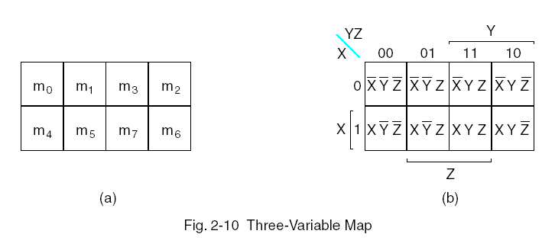
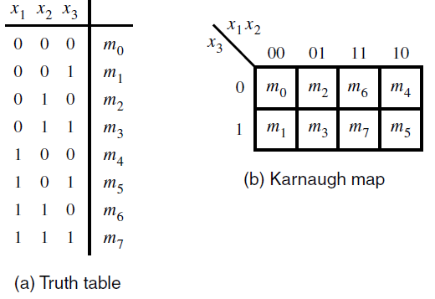
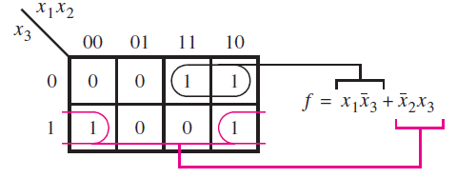
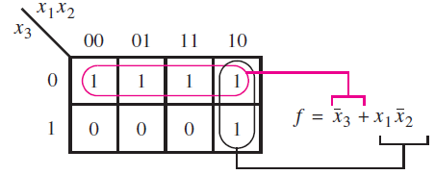
3 variable map
YZ
X
Gray code
The map should be visualised as a rectangle folded into a cylinder where the left and the right edges are made to touch

Slide 3
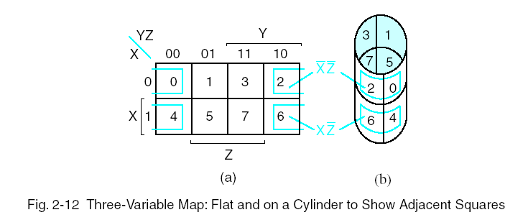
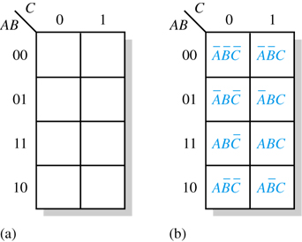
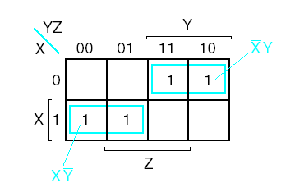
3 variable map
E.g. F(X,Y,Z)=Σm(0,2,4,6) = X′Z′+XZ ′ =Z′(X′+X)=Z′
Alternate way of writing of K-map
with 4 rows and 2 columns
E.g.. F(X,Y,Z)=Σm(2,3,4,5) =X′Y+XY′

Slide 4
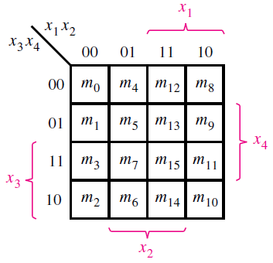
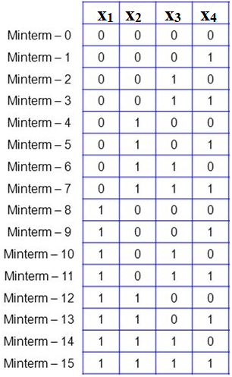
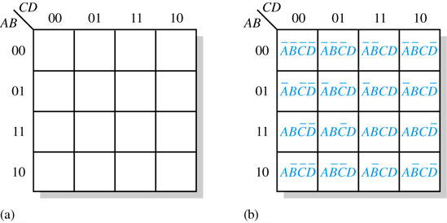
4 variable map
Truth Table
Alternate Way of writing K Map

Slide 5
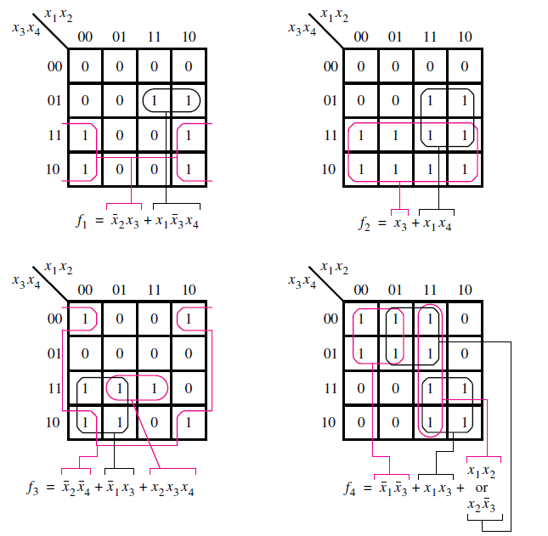
4 variable map

Slide 6
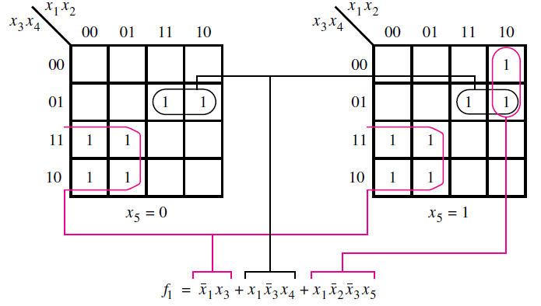
5 variable map
We can use 2 four-variable maps to construct a five-variable map. It is easy to imagine a structure where one map is directly behind the other.
They are distinguished by x₅ = 0 for one map and x₅ = 1 for the other map.

Slide 7
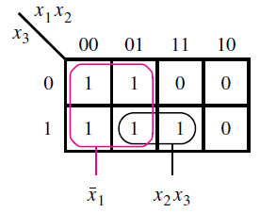
Strategy for Minimization - Terminology
Literal
Each appearance of a variable, either uncomplemented
or complemented, is called a literal.
Implicant
A product term that indicates the input valuation(s) for which a given function is equal to 1 is called an implicant of the function.
In the truth table given, there are 11 implicants.
Of which 5 are minterms given below,
Then there are the implicants that correspond to all possible pairs of minterms that can be combined (5 nos).
Finally, there is one implicant that covers a group of four minterms

Slide 8
Contd..
Prime Implicant
An implicant is called a prime implicant if it cannot be combined into another implicant that has fewer literals
Cover
A collection of implicants that account for all valuations for which a given function is equal to 1 is called a cover of that function
Eg : set of all minterms, set of prime implicants etc.
A cover also defines a particular implementation of the function. For e.g.
From the K-map a cover consisting of minterms leads to the expression
Another valid cover is given by the expression
The cover comprising the prime implicants is

Slide 9
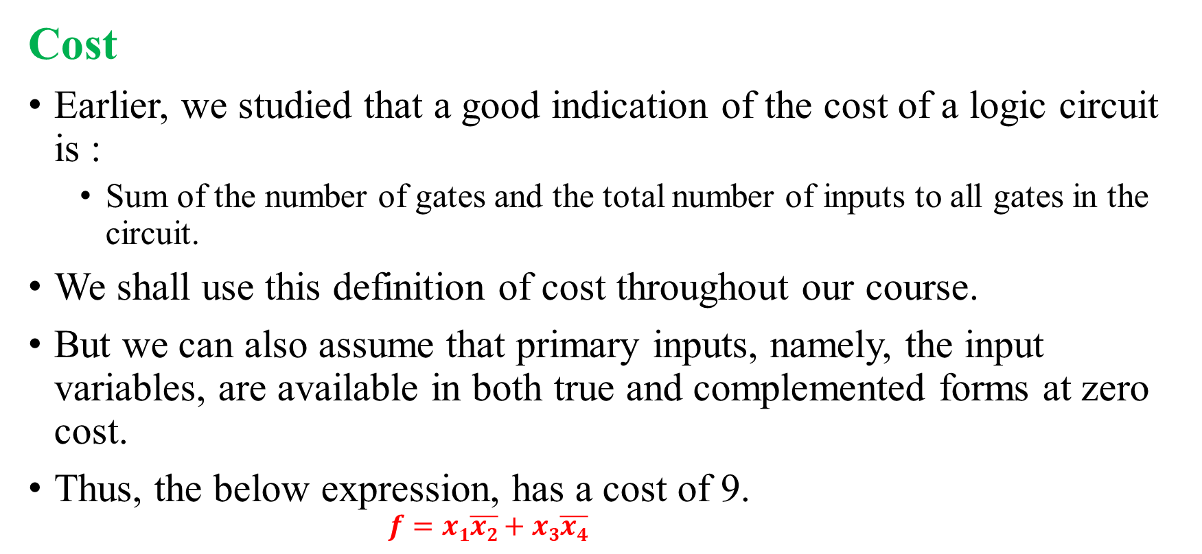
Contd..
Cost
Earlier, we studied that a good indication of the cost of a logic circuit is :
Sum of the number of gates and the total number of inputs to all gates in the circuit.
We shall use this definition of cost throughout our course.
But we can also assume that primary inputs, namely, the input variables, are available in both true and complemented forms at zero cost.
Thus, the below expression, has a cost of 9.
$$f=x1\overline{x2}+x3\overline{x4}$$

Slide 10
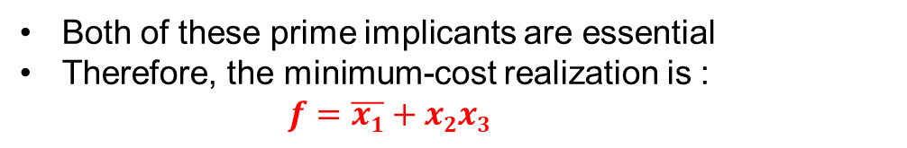
Minimization Procedure
The lowest-cost implementation is achieved when the cover of a given function consists of prime implicants.
The question then is how to determine the minimum-cost subset of prime implicants that will cover the function.
Some prime implicants may have to be included in the cover, while for others there may be a choice.
If a prime implicant includes a minterm for which f = 1 that is not included in any other prime implicant, then it must be included in the cover and is called an essential prime implicant
Both of these prime implicants are essential
Therefore, the minimum-cost realization is :
$$f=\overline{x1}+x2x3$$

Slide 11
Steps in finding minimum cost circuit
The process of finding a minimum-cost circuit involves the following steps:
1. Generate all prime implicants for the given function f .
2. Find the set of essential prime implicants.
3. If the set of essential prime implicants covers all valuations for which f = 1, then this set is the desired cover of f .
4. Otherwise, determine the nonessential prime implicants that should be added to form a complete minimum-cost cover.

Slide 12
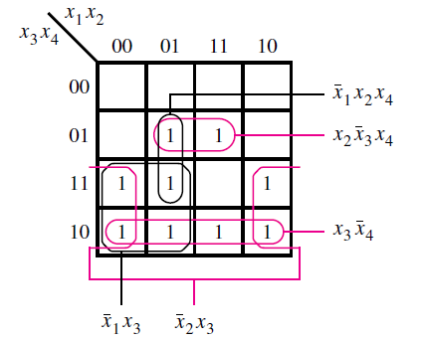


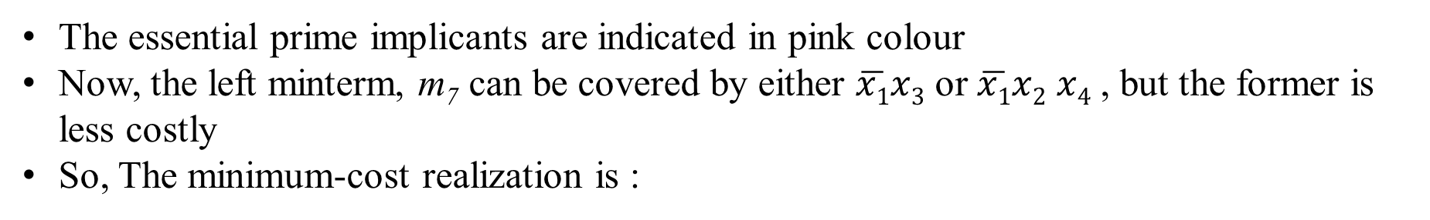
Example 1
 | 1 | 1
1 | 1 |  | 1
1 | 1 | 1 | 1
The essential prime implicants are indicated in pink colour
Now, the left minterm, m₇ can be covered by either $\overline{x1}x3$ or $\overline{x1}x2$ $x4$ , but the former is less costly
So, The minimum-cost realization is :

Slide 13
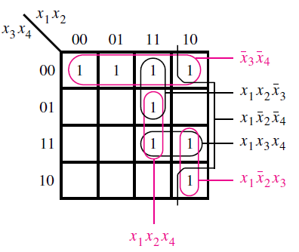
Example 2
1 | 1 | 1 | 1
 |  | 1
 |  | 1 | 1
 |  |  | 1
There is only 1 essential prime implicant but it wont cover all 1s
But, the other left out 1s can be covered as by grouping given in pink
Thus we get the least cost implementation as,

Slide 14
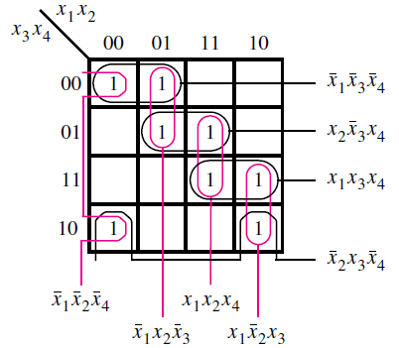
Example 3
1 | 1
 | 1 | 1
 |  | 1 | 1
1 |  |  | 1
Here, there is no any essential prime implicant
And there is 2 implementations possible
and

Slide 15
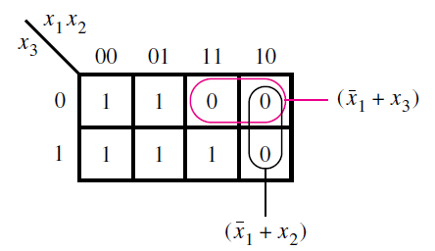

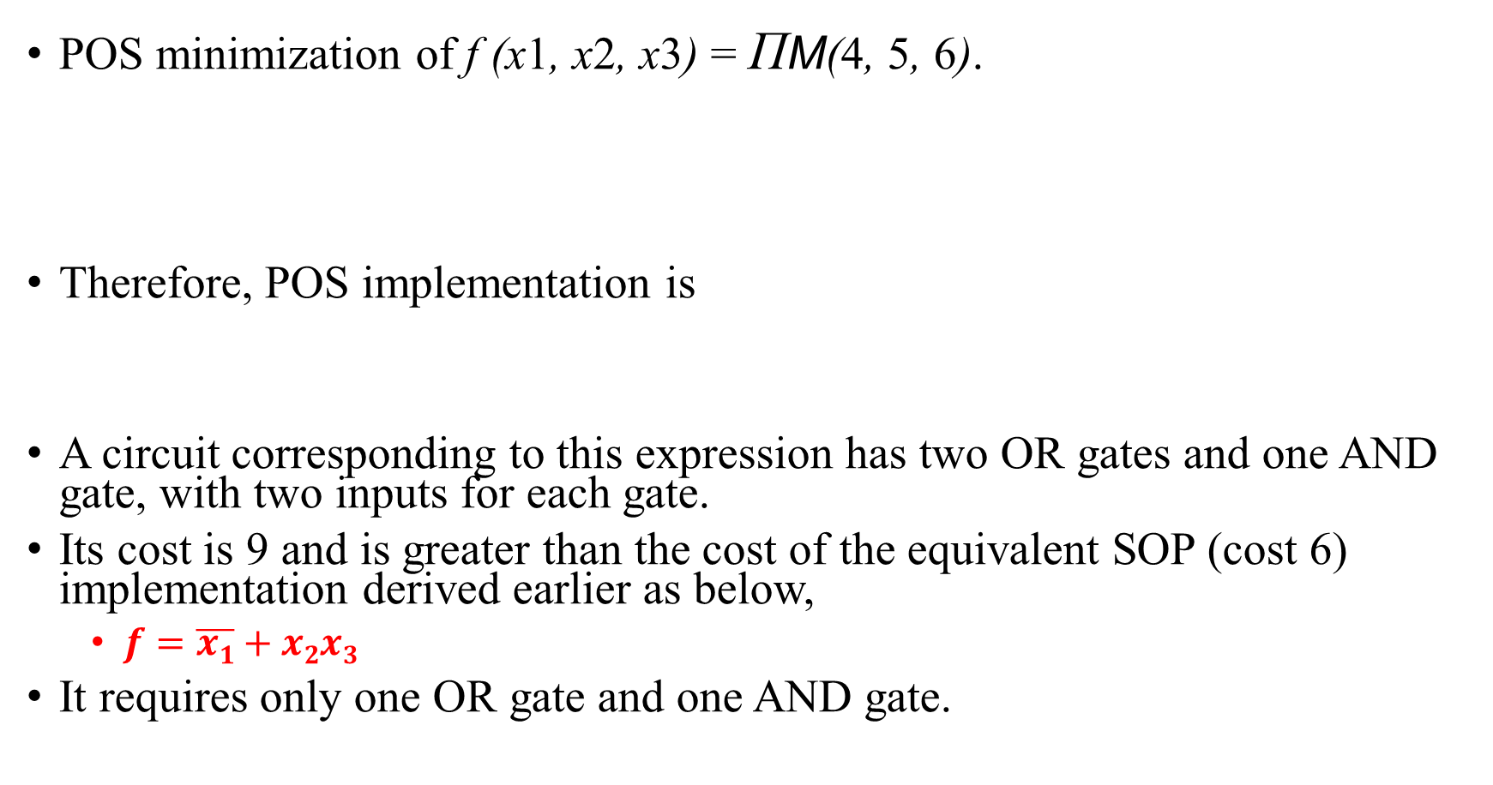
Minimization of Product-of-Sums Forms
POS minimization of f (x1, x2, x3) = ΠM(4, 5, 6).
Therefore, POS implementation is
A circuit corresponding to this expression has two OR gates and one AND gate, with two inputs for each gate.
Its cost is 9 and is greater than the cost of the equivalent SOP (cost 6) implementation derived earlier as below,
$f=\overline{x1}+x2x3$
It requires only one OR gate and one AND gate.

Slide 16

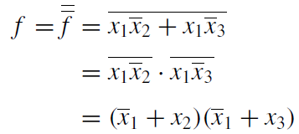
Contd.
Another way of obtaining the same result
is by finding a minimum-cost SOP
implementation of the complement of f .
Then we can apply DeMorgan’s theorem to this expression to obtain the simplest POS realization

Slide 17
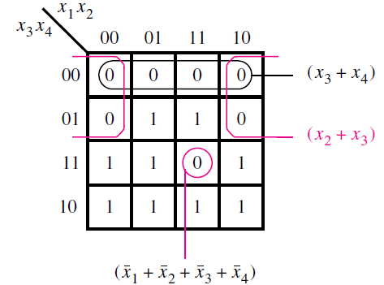
Example 2
f (x₁, . . . , x₄) = ΠM(0, 1, 4, 8, 9, 12, 15).
POS minimization is obtained by
combining maxterms.
The maxterms for which f = 0 can be covered as shown, leading to the least cost expression

Slide 18
Contd.
So POS implementation is:
This expression represents a circuit with three OR gates and one AND gate.
Two of the OR gates have two inputs, and the third has four inputs
The AND gate has three inputs.
Thus cost is 15
The SOP implementation for the same K- map is
It requires five gates and 13 inputs at a total cost of 18 which is higher than the POS implementation.
In general, the SOP and POS implementations of a given function may or may not entail the same cost.

Slide 19

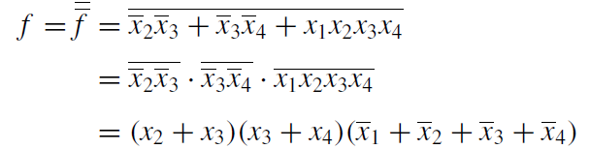
Contd.
Alternatively, we can express as,
Complementing this expression produces
which matches the previously-derived implementation.

